Slide 1
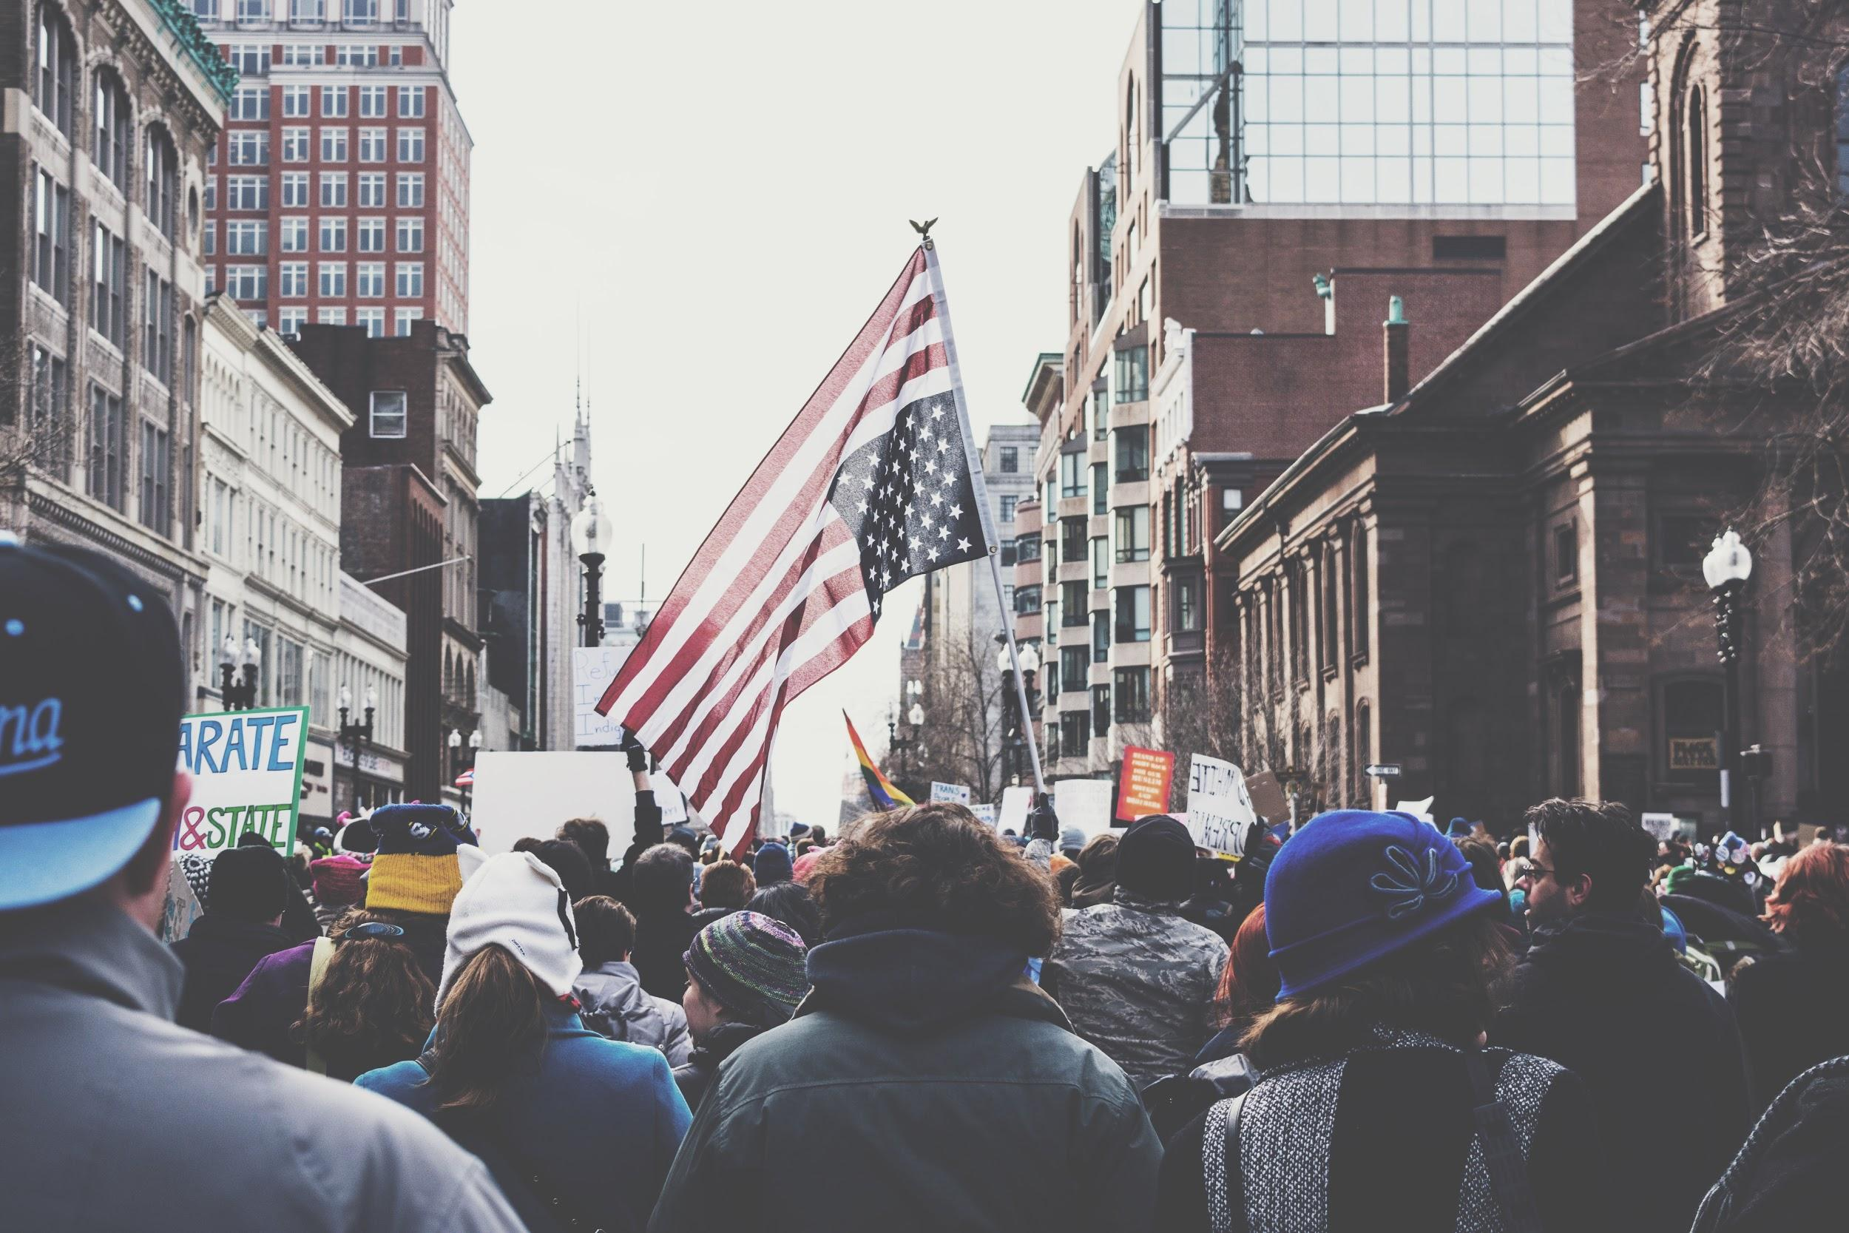
HOWBIASED
detecting bias in media

Slide 2
Contact info
rob@lingistic.com
http://howbiased.com
http://lingistic.com

Slide 3
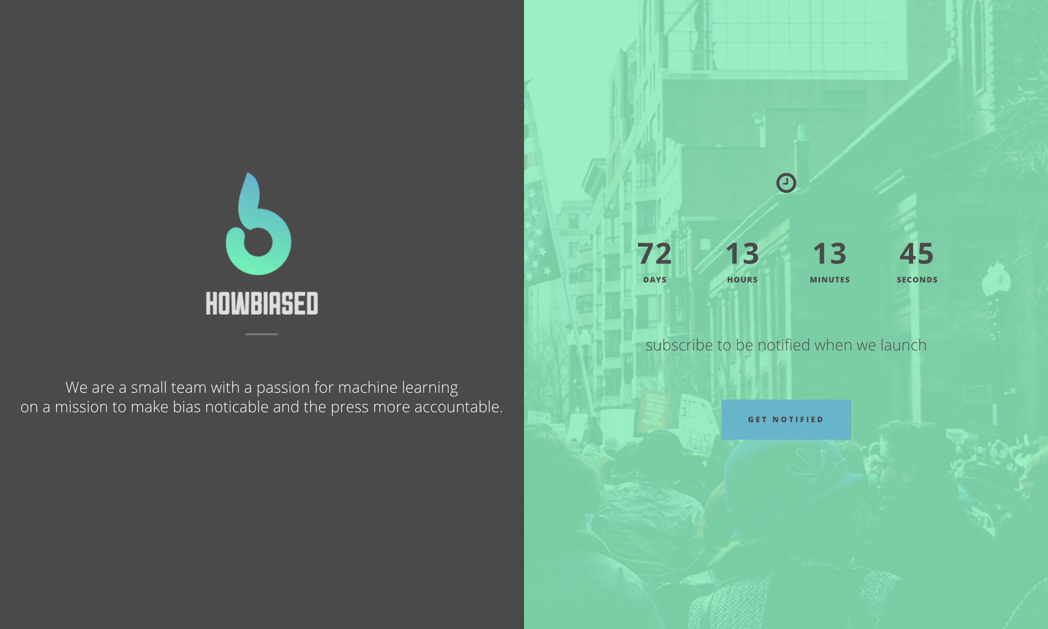

Slide 4

Responsibility in journalism: Using AI to detect biased language
Notes:
Has been an interest of mine for a long time
Fascinated by semantics and hidden, latent signals in text
Troubled by the inability of people to notice bias in articles.

Slide 5
The problem
60% of Americans say that the media has a clear political bias (Gallup, 4/2017)
Most Americans (53%) prefer to get their news from sources that align with their political views (First Amendment Center)
70% of the general public agrees that news organizations are subject to partisan agendas
Notes:
Interestingly, people know the news is biased
Yet they self-select anyway

Slide 6
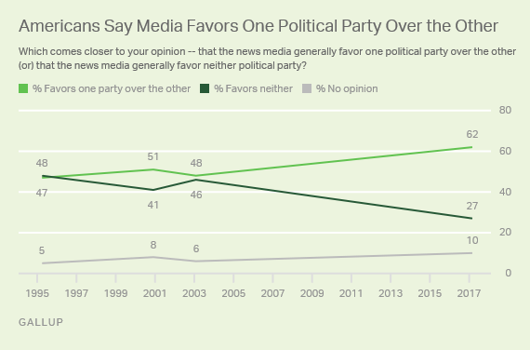
AND IT’S GETTING WORSE OVER TIME

Slide 7
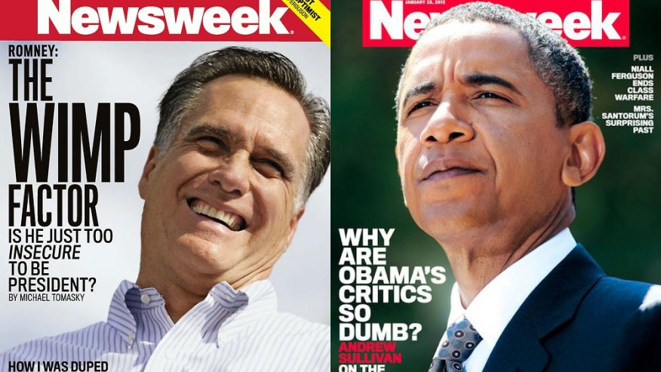
Notes:
Even the big publishers are getting in on it

Slide 8
Existing Solutions?
Human-driven: slow, and non-deterministic
-- Open to new bias
Mostly focused on accuracy
-- Actually quite a different problem
Politifact
Snopes
Google Research

Slide 9
Start where you are.
Use what you have.
Do what you can.
-- Arthur Ashe

Slide 10
framing bias
“Classic”
Subjective; one-sided; stance-based (Entman, 2007)
Existing literature: stance recognition, subjectivity
lexicon-based, classification
positive/negative classification (subjectivity, polarity)
stance detection: classification into one of two opposing views

Slide 11
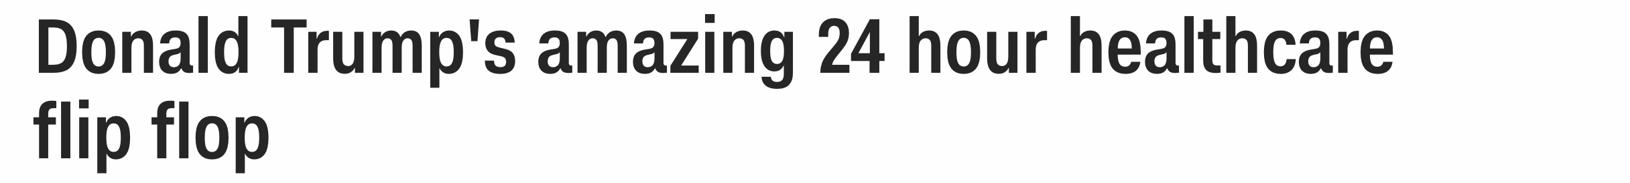
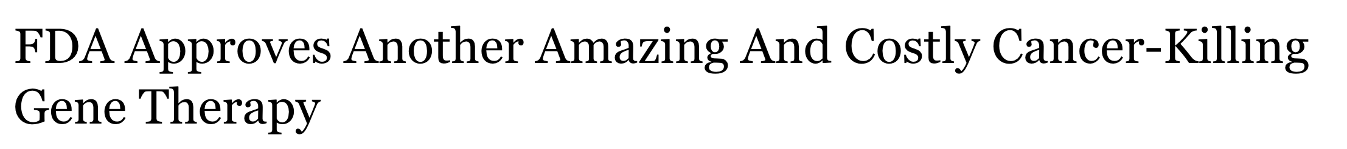
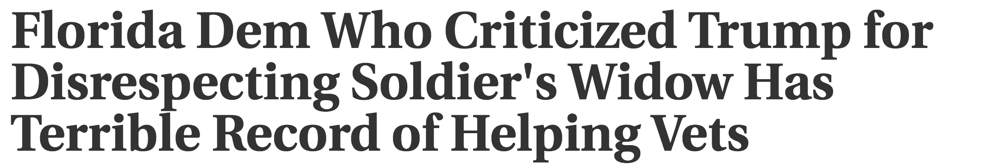
Framing Bias: Type 1 -- Subjective Intensifiers

Slide 12
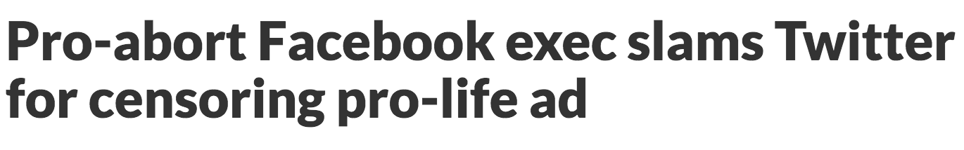
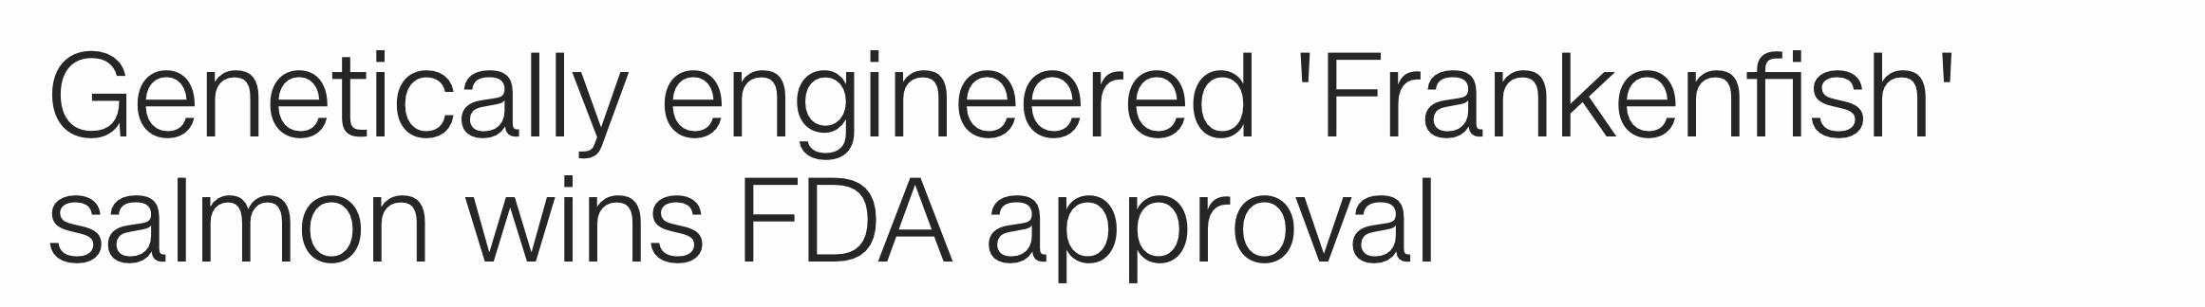
Framing Bias: Type 2 -- one-sided phrases

Slide 13
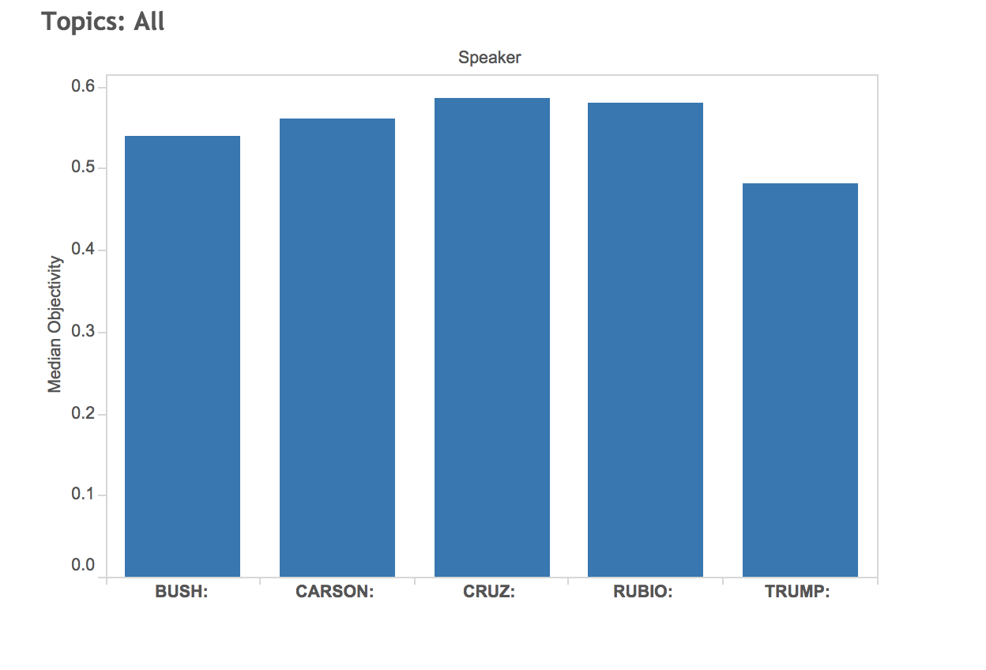
Initial analysis
Semantic/Topical analysis of GOP debates
Subjectivity
Specificity
Polarity
Compact vocabulary and small dataset makes for perfect playground
Political nature of vocab ensures the presence of bias.
Can you spot the least objective candidate?

Slide 14
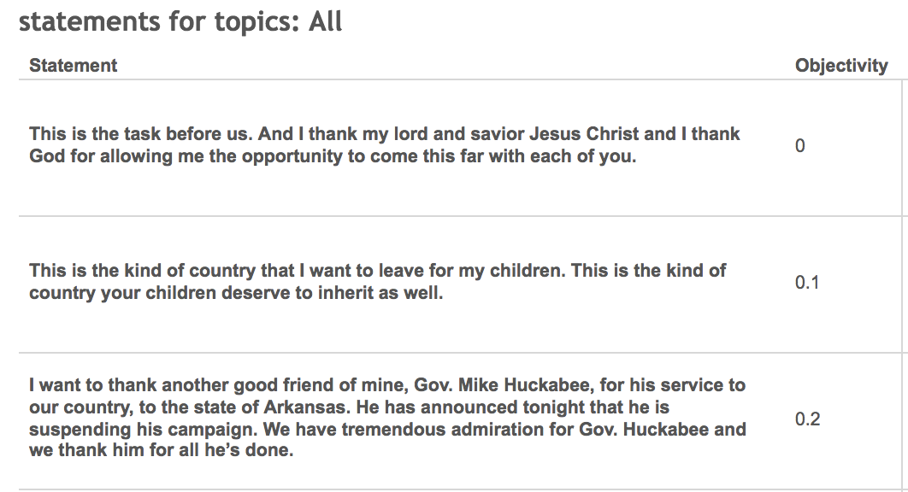

Slide 15
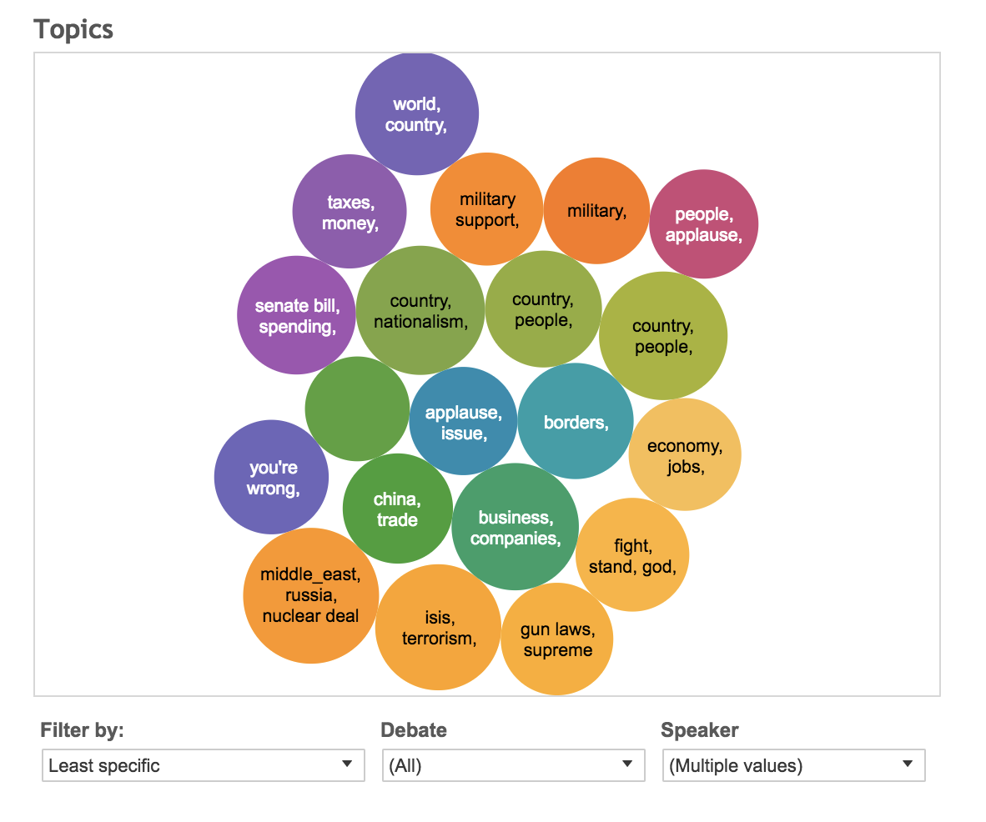
Topic Experimentation
Find most and least specific/polarized/objective topic
Unsupervised, LDA-based n-gram model
Filter topics by “bias” (framing bias)
Statistical tricks -- isolate significant phrases and n-grams, etc.

Slide 16
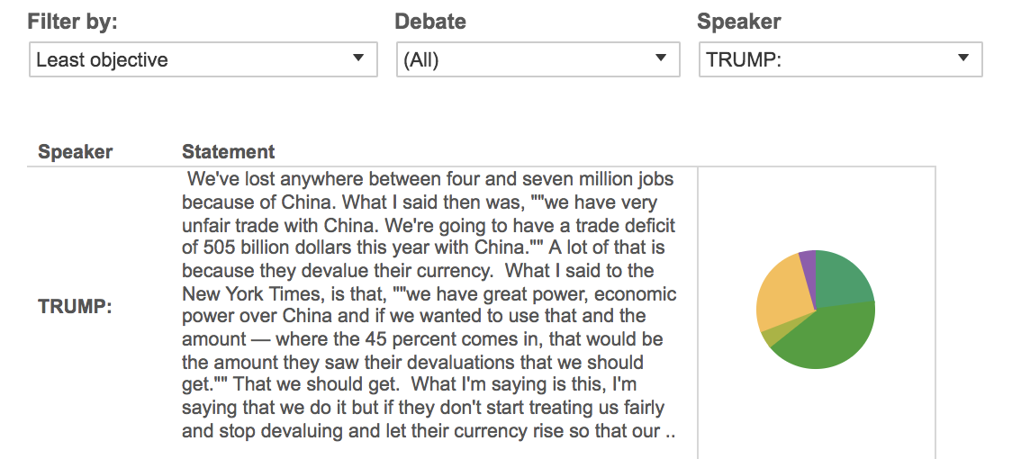
Not bad -- fun results

Slide 17
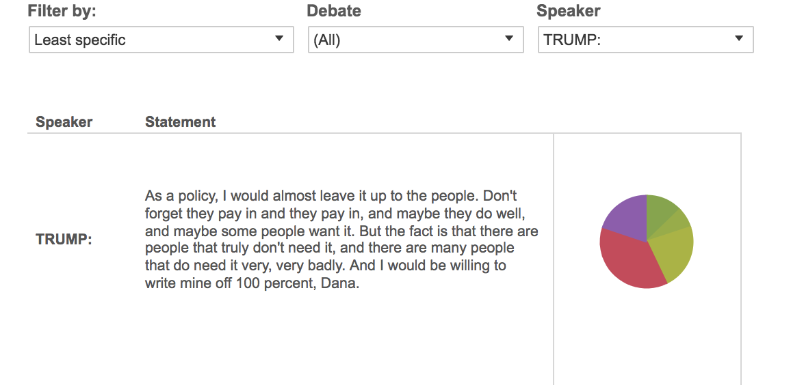

Slide 18
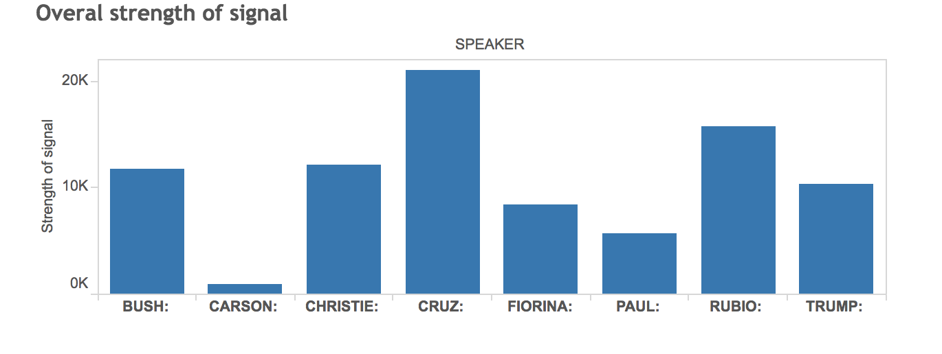
Measuring information gain
Can we measure not only subjectivity and specificity, but information gain?
Calculate an overall "strength of signal" index based on the overall information gain of the phrase relative to the entire debate performance.
Group the significant phrases by speaker and rank the phrase's overall importance to the candidate's message.

Slide 19
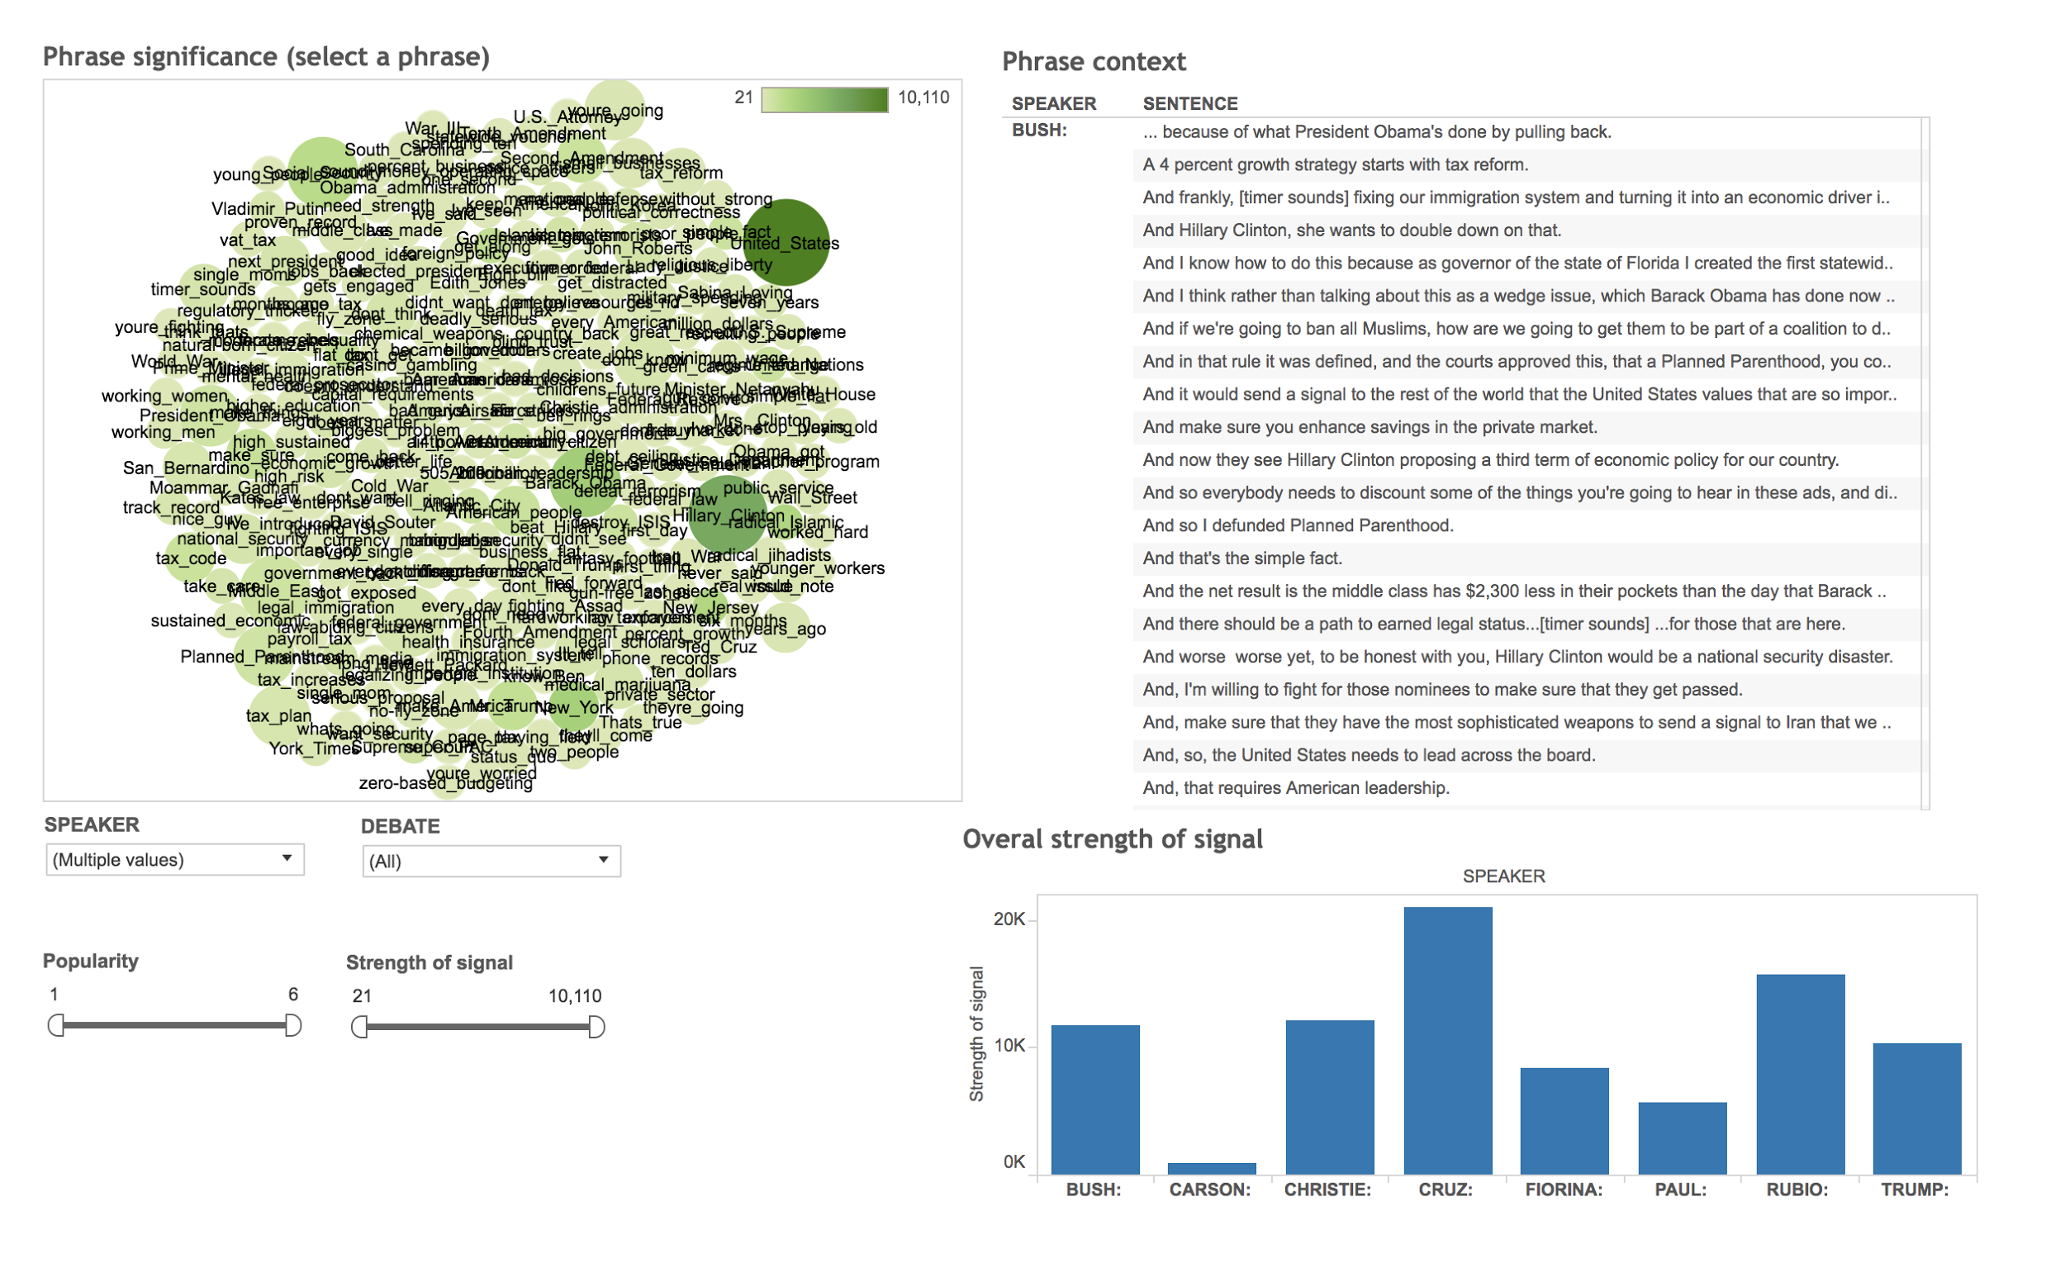

Slide 20
First Prototype: Chrome Extension
Bootstrapped via subjectivity/polarity/opinion lexicons
Opinion lexicon from Liu et al. (2005)
Lexicon of subjective words from Riloff and Wiebe (2003)
Common features: “I believe,” “unlikely,” etc.
Mostly off the shelf models

Slide 21
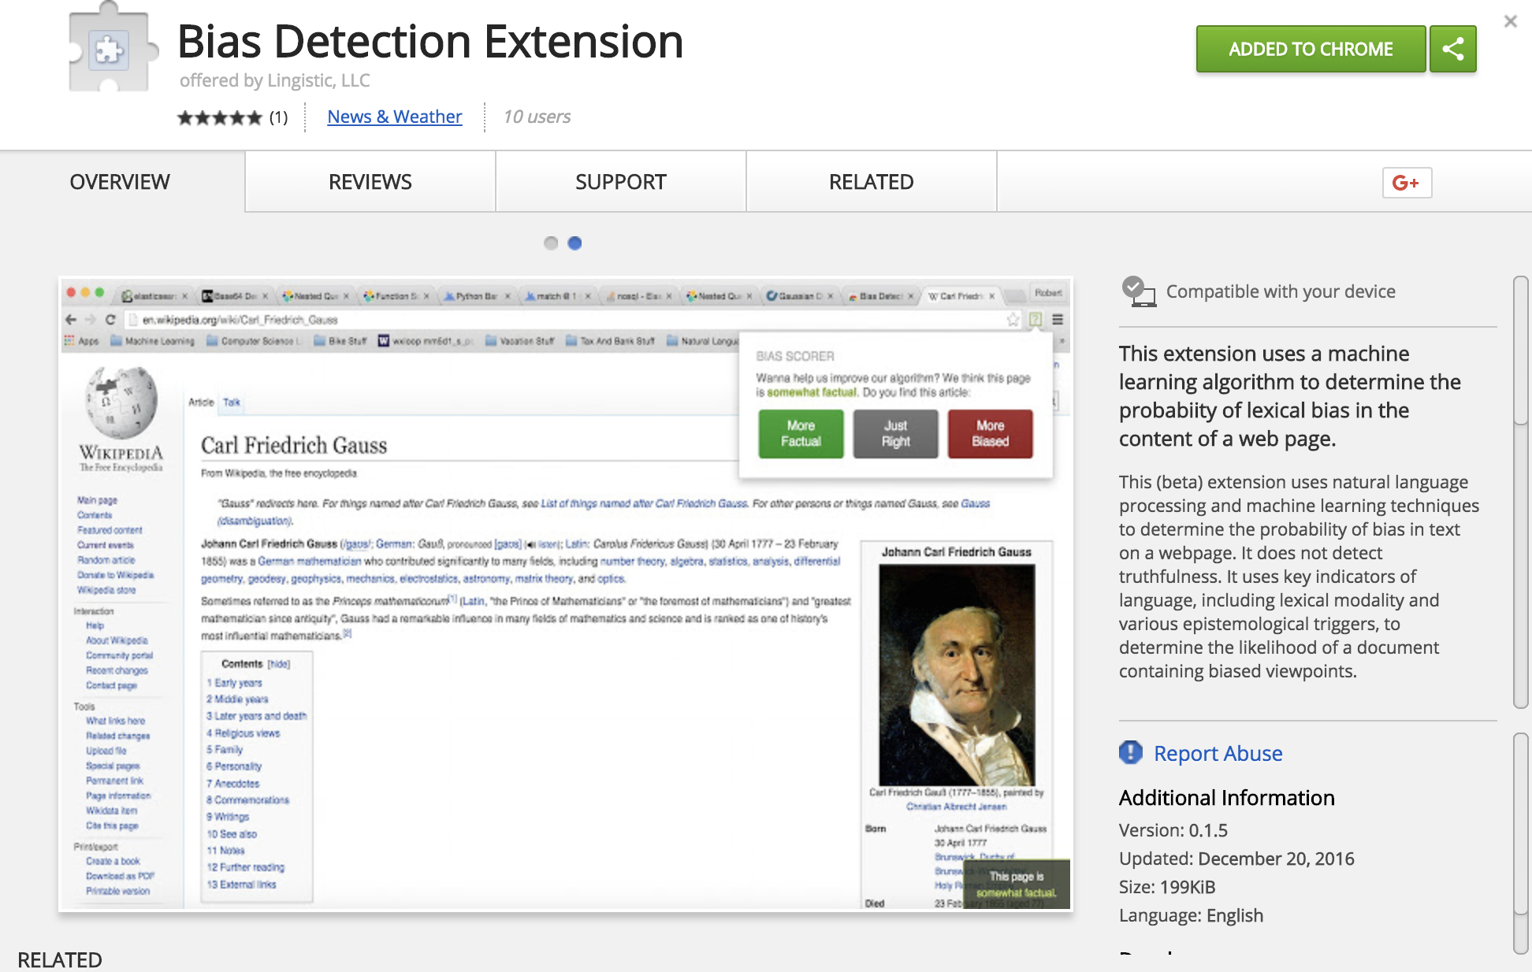
Chrome extension -- model features
SVM-based
Context-specific ngram/unigram features
Polarity/Subjectivity/Specificity features
Topic and keyword lexicons
100,000+ crowd-sourced articles
Wikipedia corpus (NPOV articles)

Slide 22
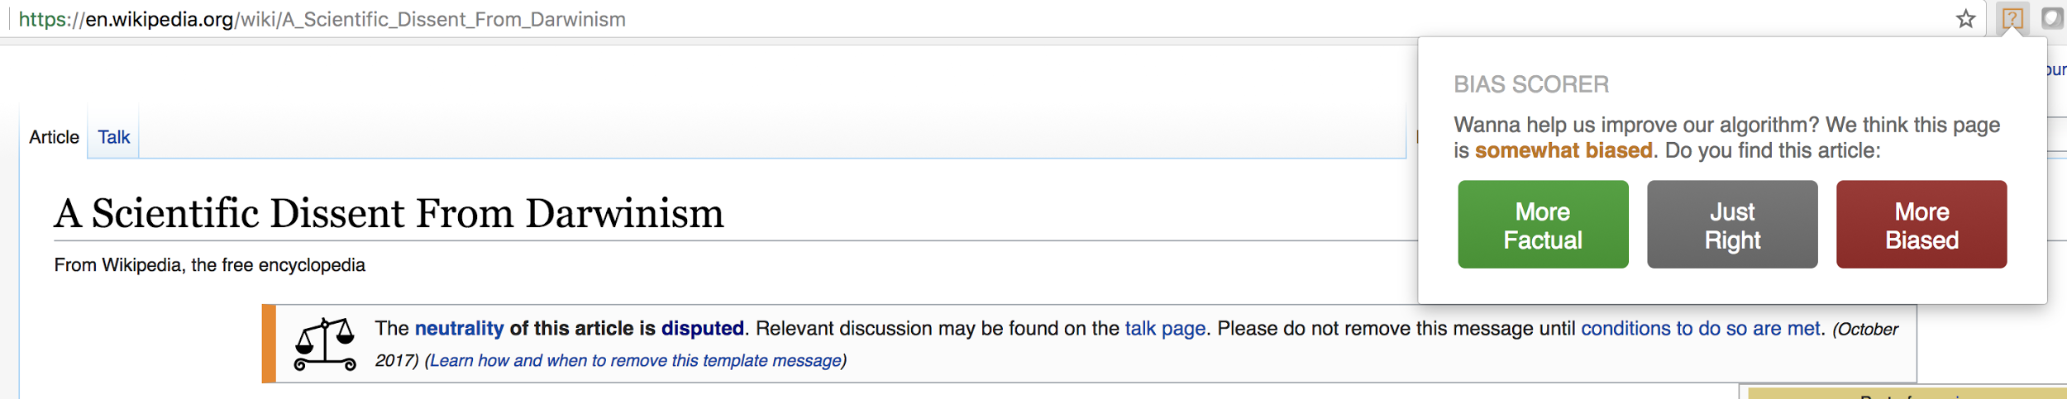
Probably a good idea to test against wikipedia first

Slide 23
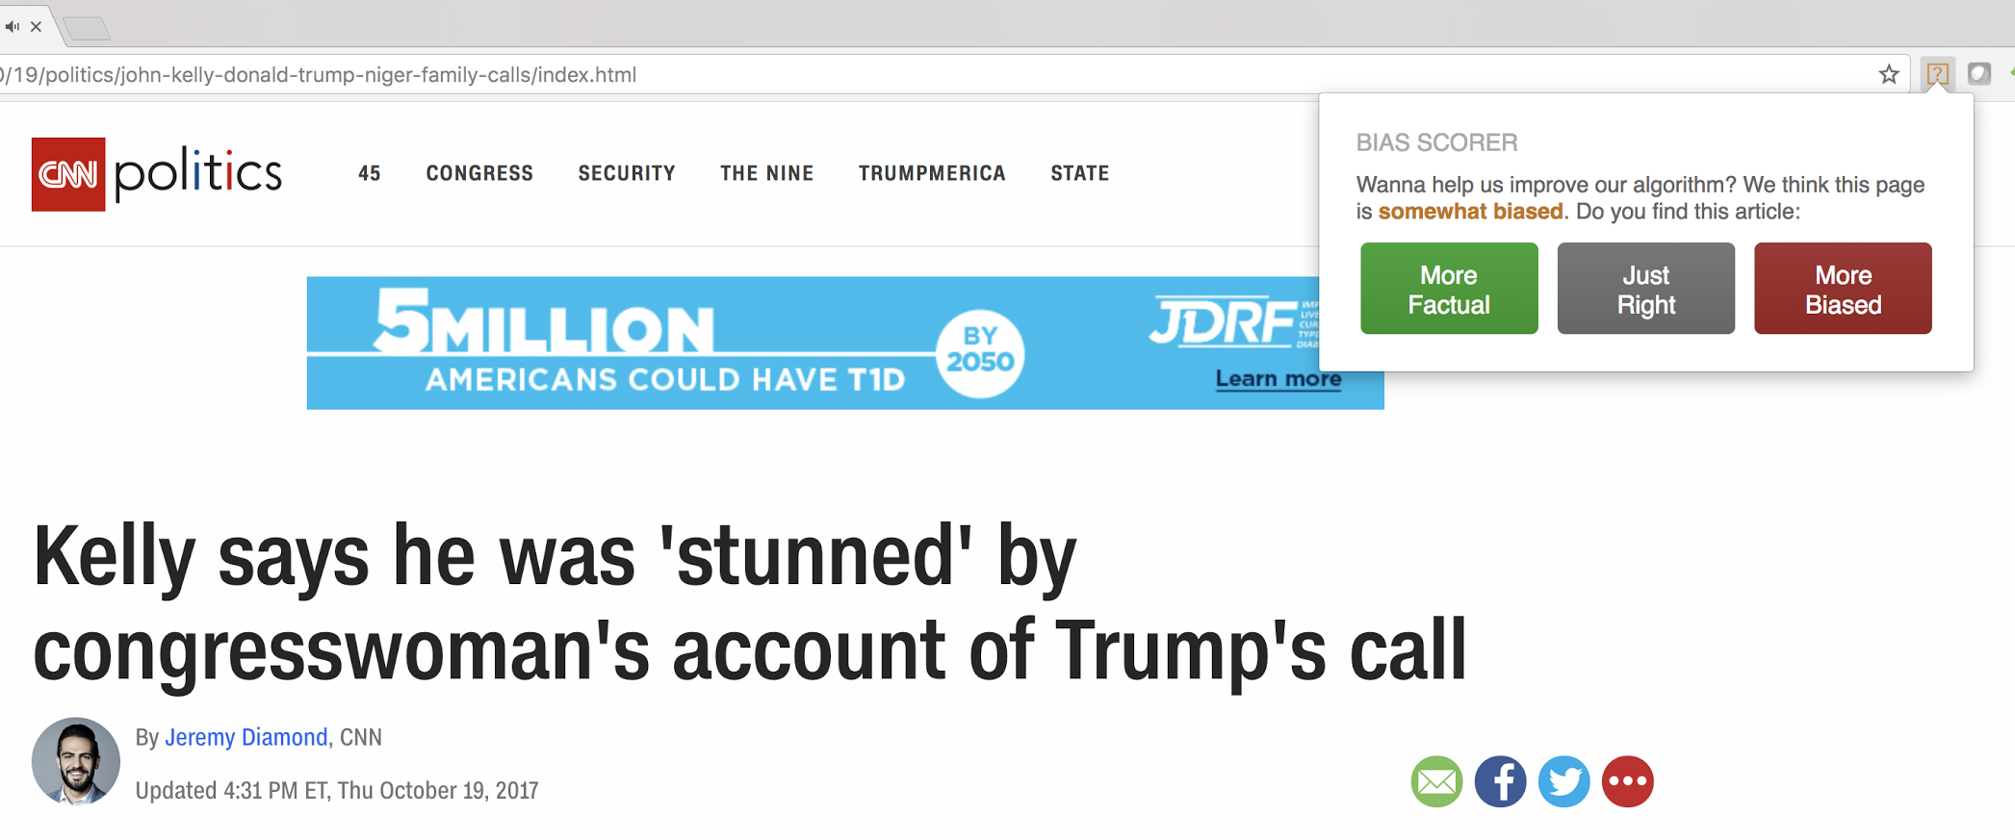
Not Bad

Slide 24
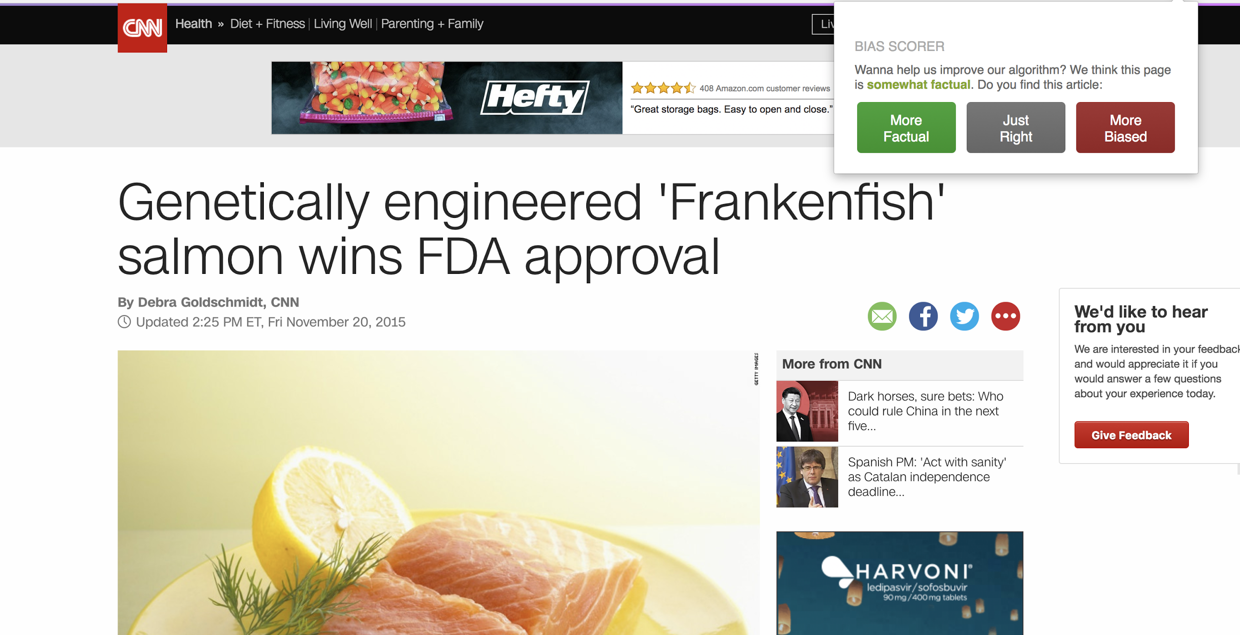
OOPS!

Slide 25
Challenges
Turns out: stance detection is a difficult problem
So is subjectivity. “I hate cancer.” Positive? Negative?
Need more signal! Time for some research.

Slide 26
Signal boosting -- Epistemologically
Epistemological bias -- bidirectional!
Casts doubt on things commonly assumed to be true, or presupposes about a proposition commonly assumed to be false. (Danescu-Niculescu-Mizil, Jurafsky, and Recasens, 2013)
Harder, less “classic,” and humans are bad at detecting this kind of subtle bias.
Plenty of prior literature (see appendix)

Slide 27
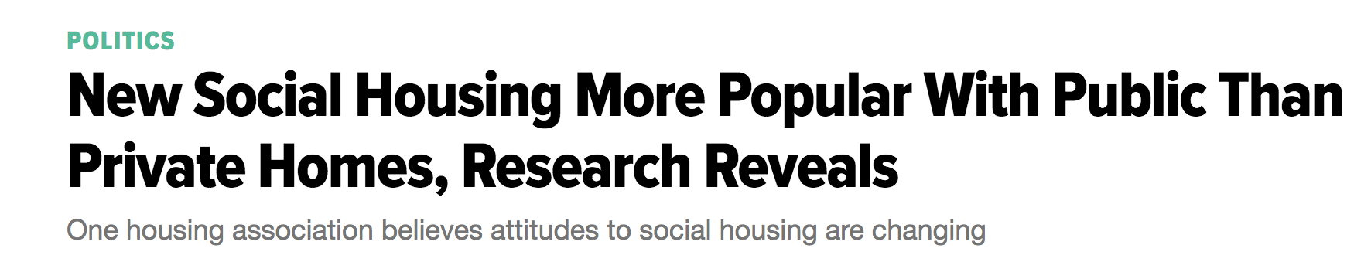
Factive verbs
(Kiparsky and Kiparsky, 1970)
presuppose the truth of their complement clause.

Slide 28
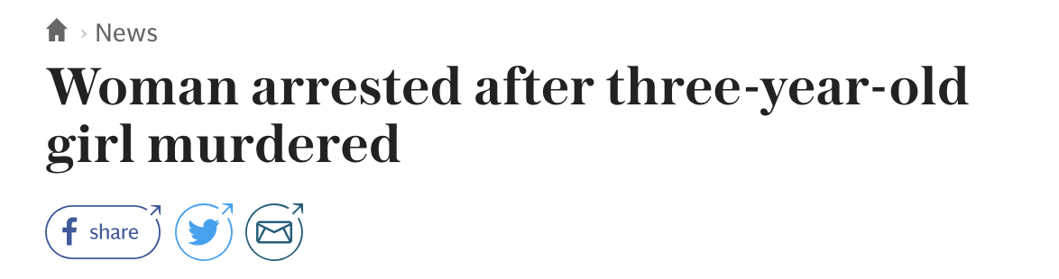
Entailments
The truth of one thing follows naturally from the other
Lexicon: Shallow and syntactic entailments from Berant et al. (2012)

Slide 29
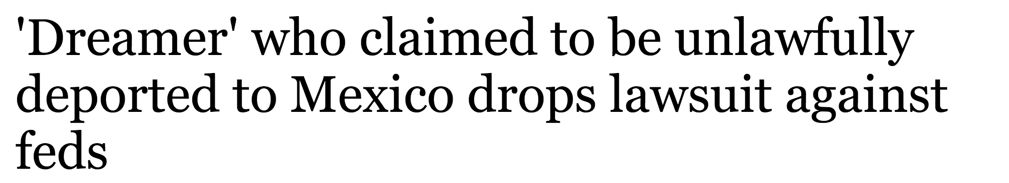
Assertive Verbs
Cast doubt on the certainty of their complement clause

Slide 30
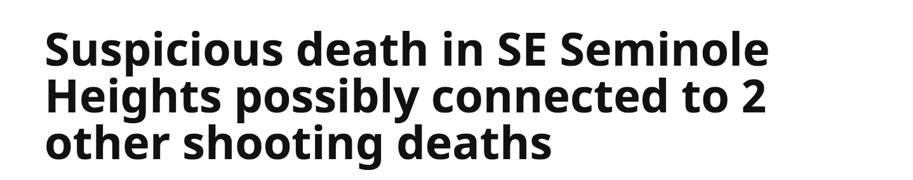
Hedges
Hedges are used to reduce one’s commitment to the truth of a proposition, thus avoiding any bold predictions or statements (Danescu-Niculescu-Mizil, et. al 2013)

Slide 31
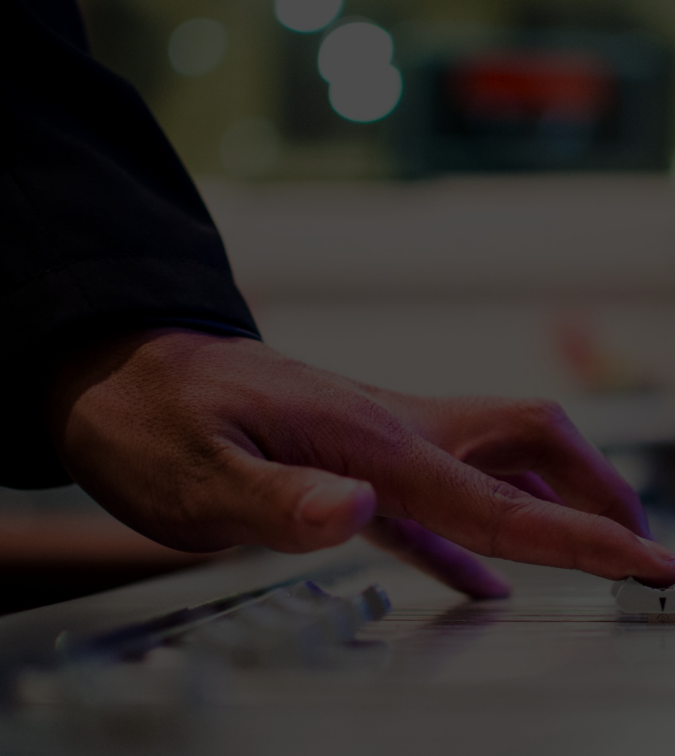
Better bias detection
Subjectivity/Polarity features against hand-curated corpus was “OK” -- but lacked precision
What if we add epistemological features?

Slide 32

Wikipedia NPOV
Show the audience you anticipated their questions.
Leave room for Q&A, but use the Appendix as a way to show that you both thought about those questions and have solid answers with supporting information. Let the audience test their understanding of the problem and the solution you’ve outlined - questions give them a chance to talk themselves into your approach, and give you a chance to show mastery of the subject.
~5 million revisions from “NPOV” tagged articles
Tokenize and split revisions
Mine actual NPOV edits (not spelling errors, etc.) based on revision comments
Diff revisions to identify words which were changed to remove NPOV label
Identify pranksters and trolls by creating reputation model (track back-and-forth edits, overridden edits, etc.)

Slide 33
Features
word | string
lemma | string
pos | {NNP, JJ, etc}
position in sentence | {start, middle, end}
word is in epist. lexicon | {true,false} X 10
word is in framing lexicon | {true, false} X 10
strong subjective | {true, false}
weak subjective | {true, false}
positive | {true, false}
negative | {true, false}
syntactic dependencies | {root, subject, object}
Topic (of sentence) | int
most similar word embedding (in sentence) | string
~ 40 features
polarity/subjectivity/specificity
epistemological tokens
topics and word-embeddings
POS @ other syntactic features
5-gram context window

Slide 34
The pipeline
Pre-process
Filter (bayesian)
Feature extraction
Prediction (MLP)
Clean, tokenize, lemma
Do we have a high probability that the input string is similar enough to our training data?
Binary classification -- word is or isn’t biased

Slide 35
Results
~ 68% accuracy against test data, top 3 (Wikipedia NPOV)
~ 61% accuracy in position 1
Human testers achieved ~40% accuracy against test corpus
Wikipedia’s own “words to avoid” list has nearly zero predictive power.
Future testing: “Can you beat the AI?” game, for additional crowdsourced testing.
Future product addition: Word correction

Slide 36


enter url
Coming soon….

Slide 37
REFERENCES
Rani Nelken and Elif Yamangil. 2008. Mining Wikipedia article revision history for training Computational Linguistics algorithms. In Proceedings of the 1st AAAI Workshop on Wikipedia and Artificial Intelligence.
Aurelien Max and Guillaume Wisniewski. 2010. Mining naturally-occurring corrections and paraphrases from Wikipedia’s revision history. In Proceedings of LREC 2010, pages 3143–3148.
Fabio M. Zanzotto and Marco Pennacchiotti. 2010. Expanding textual entailment corpora from Wikipedia using co-training. In Proceedings of the 2nd Coling Workshop on The People’s Web Meets NLP: Collaboratively Constructed Semantic Resources, pages 28–36.
Danescu-Niculescu-Mizil, C., Jurafsky, D., & Recasens, M. (2013). Linguistic Models for Analyzing and Detecting Biased Language. ACL.
Mark Yatskar, Bo Pang, Cristian Danescu-Niculescu-Mizil, and Lillian Lee. 2010. For the sake of simplicity: Unsupervised extraction of lexical simplifi- cations from Wikipedia. In Proceedings of NAACLHLT 2010, pages 365–368.
Robert M. Entman. 2007. Framing bias: Media in the distribution of power. Journal of Communication, 57(1):163–173.

